Slide 1
Milestone 1 Presentation
Robert Claud

Slide 2
Project Initiation
Started this project after two failed attempts at other projects with companies
First Project: Particle Monitoring System for Northrop Grumman
Unsuccessful due to cybersecurity policies related to working in the defense industry
The timeline for this class was not long enough to account for sufficient cybersecurity review and approval by the company
Second Project: Mobile Test Station for Dormakaba
Unsuccessful due to a lack of communication with assigned partner
Was unable to contact appropriate stakeholders
Will move forward with monitoring a home appliance

Slide 3
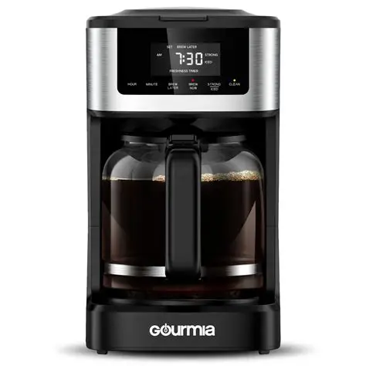
Project Description
Work that needs to be done
Develop appropriate mounts for the sensors onto the coffee maker
Write Python scripts to interface with the sensors and collect data
Develop Machine Learning models to detect when coffee is brewed
Technology and devices used
DS18B20 Thermocouple to monitor how hot the water tank gets while brewing coffee
ADXL345 Accelerometer to monitor the pumping of water from the water tank to the pot above the grounds
Problem that will be solved
Identifying when my coffee is done in case I walk away.

Slide 4
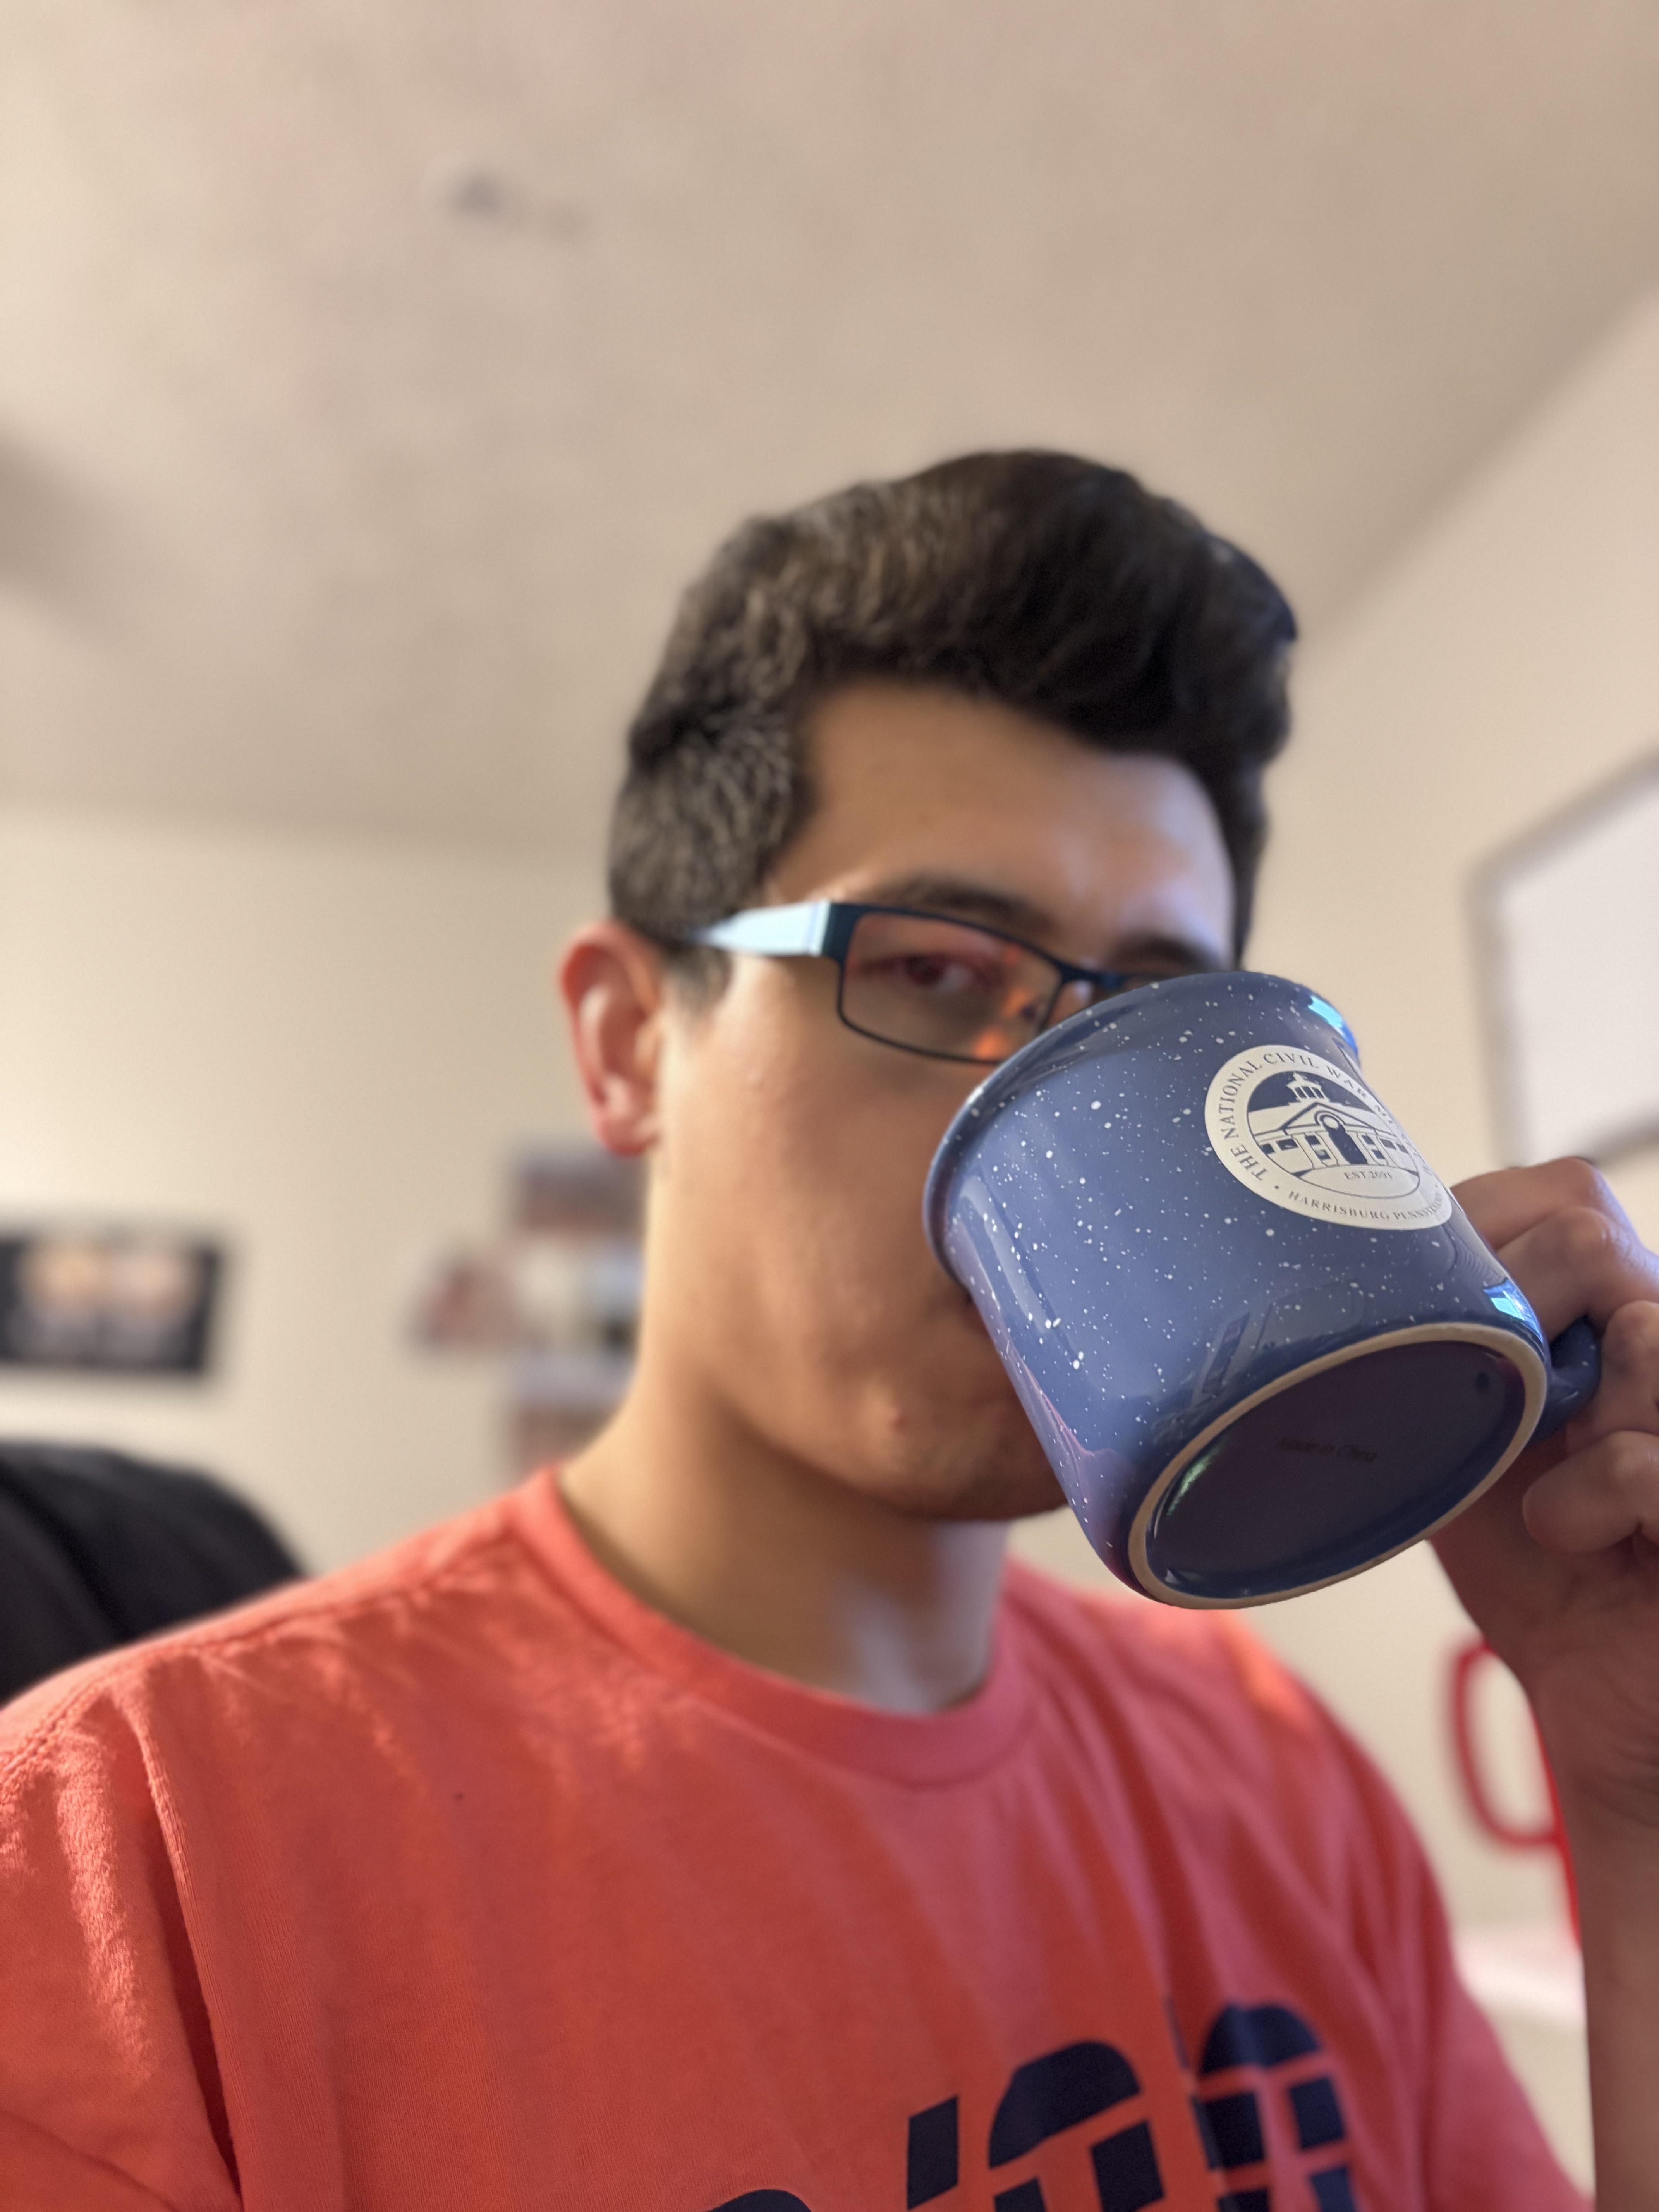
Target Audience
ME!
Anyone who loves coffee
And is super busy and prone to walking away while coffee is being brewed
Needs
A system to notify and monitor the status of a fresh batch of coffee
Background and expertise
Busy professional engineer and graduate student

Slide 5
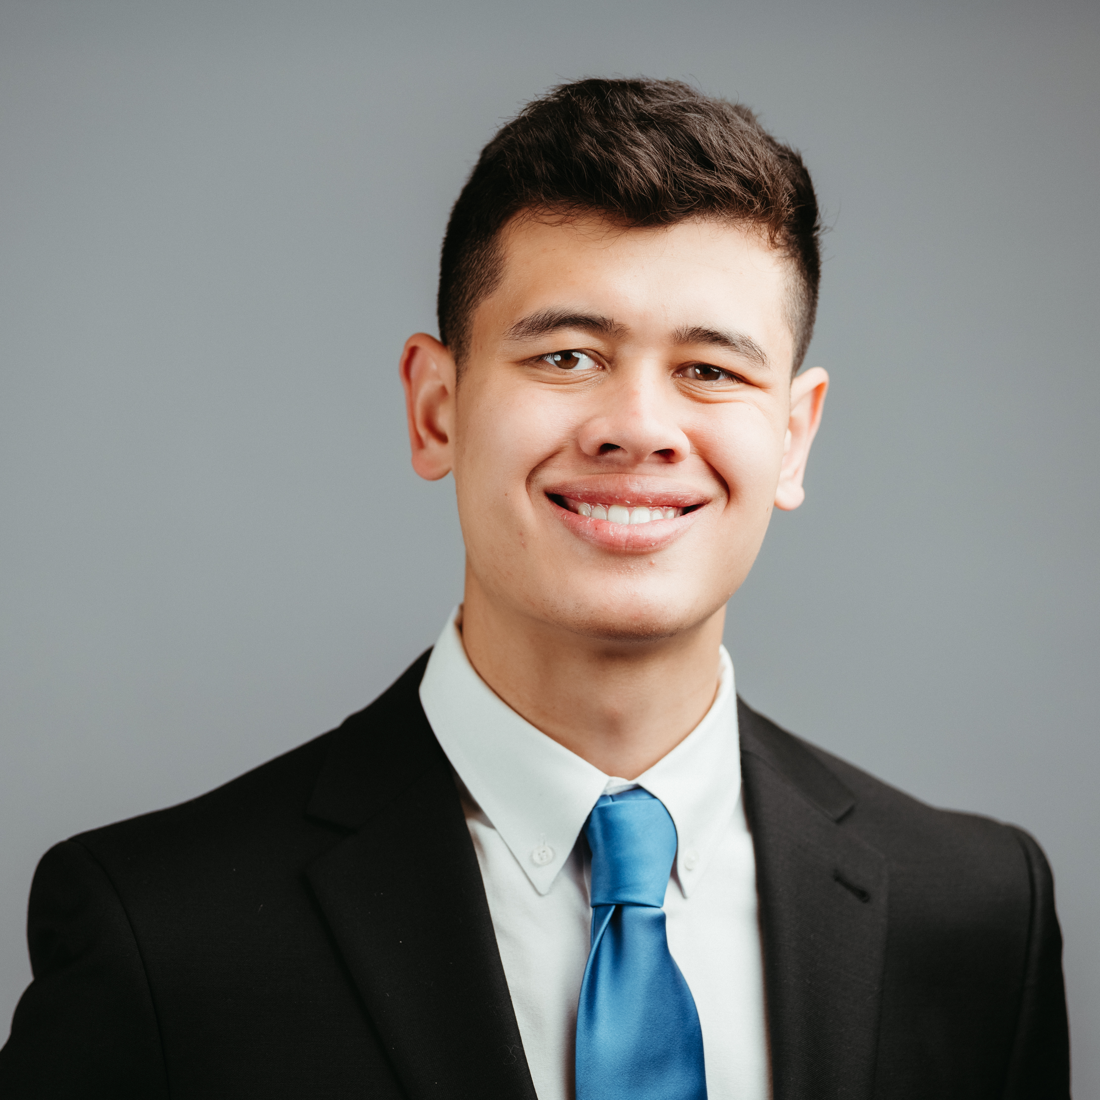
Roles and Responsibilities
Expertise
Microelectronics Semiconductor Engineer working at Northrop Grumman
Day-to-day tasks as a full-stack software engineer
Developing frontend web applications using TypeScript and React
Developing backend APIs in Python using Flask or FastAPI frameworks
Networking with industrial automation sensors and devices catered for the Semiconductor Industry
Prior experience as a Mechanical Hardware Engineer
Performed structural analysis on components for use in undersea environments
Developed CAD models for electronic enclosures

Slide 6
Roles and Responsibilities
Responsibilities
I will be handling the entirety of the project. I will be responsible for:
Acquiring appropriate mounts for the sensors
Designing in CAD and 3D printing if needed
Writing a Python script to read the data using MTConnect
Developing a relational database schema using MySQL
Developing a user interface either in Grafana or a full web application using TypeScript/React
Developing machine learning models to notify when coffee is brewed
I will need support from the TA Yuseop Sim as a resource and mentor for this project
Acting in an advisory or consulting role

Slide 7


Communication Channels
Will communicate on an as-need basis with the professor and TA using teams or outlook emails

Slide 8






Resources
Software
Frontend Development
Use TypeScript as the language
Web application using the React framework
Bundled using Vite
Relational Database
Schema developed in MySQL
Machine Learning Models
Models will be developed using TensorFlow
Will utilize Jupyter Notebooks for writing the algorithms

Slide 9
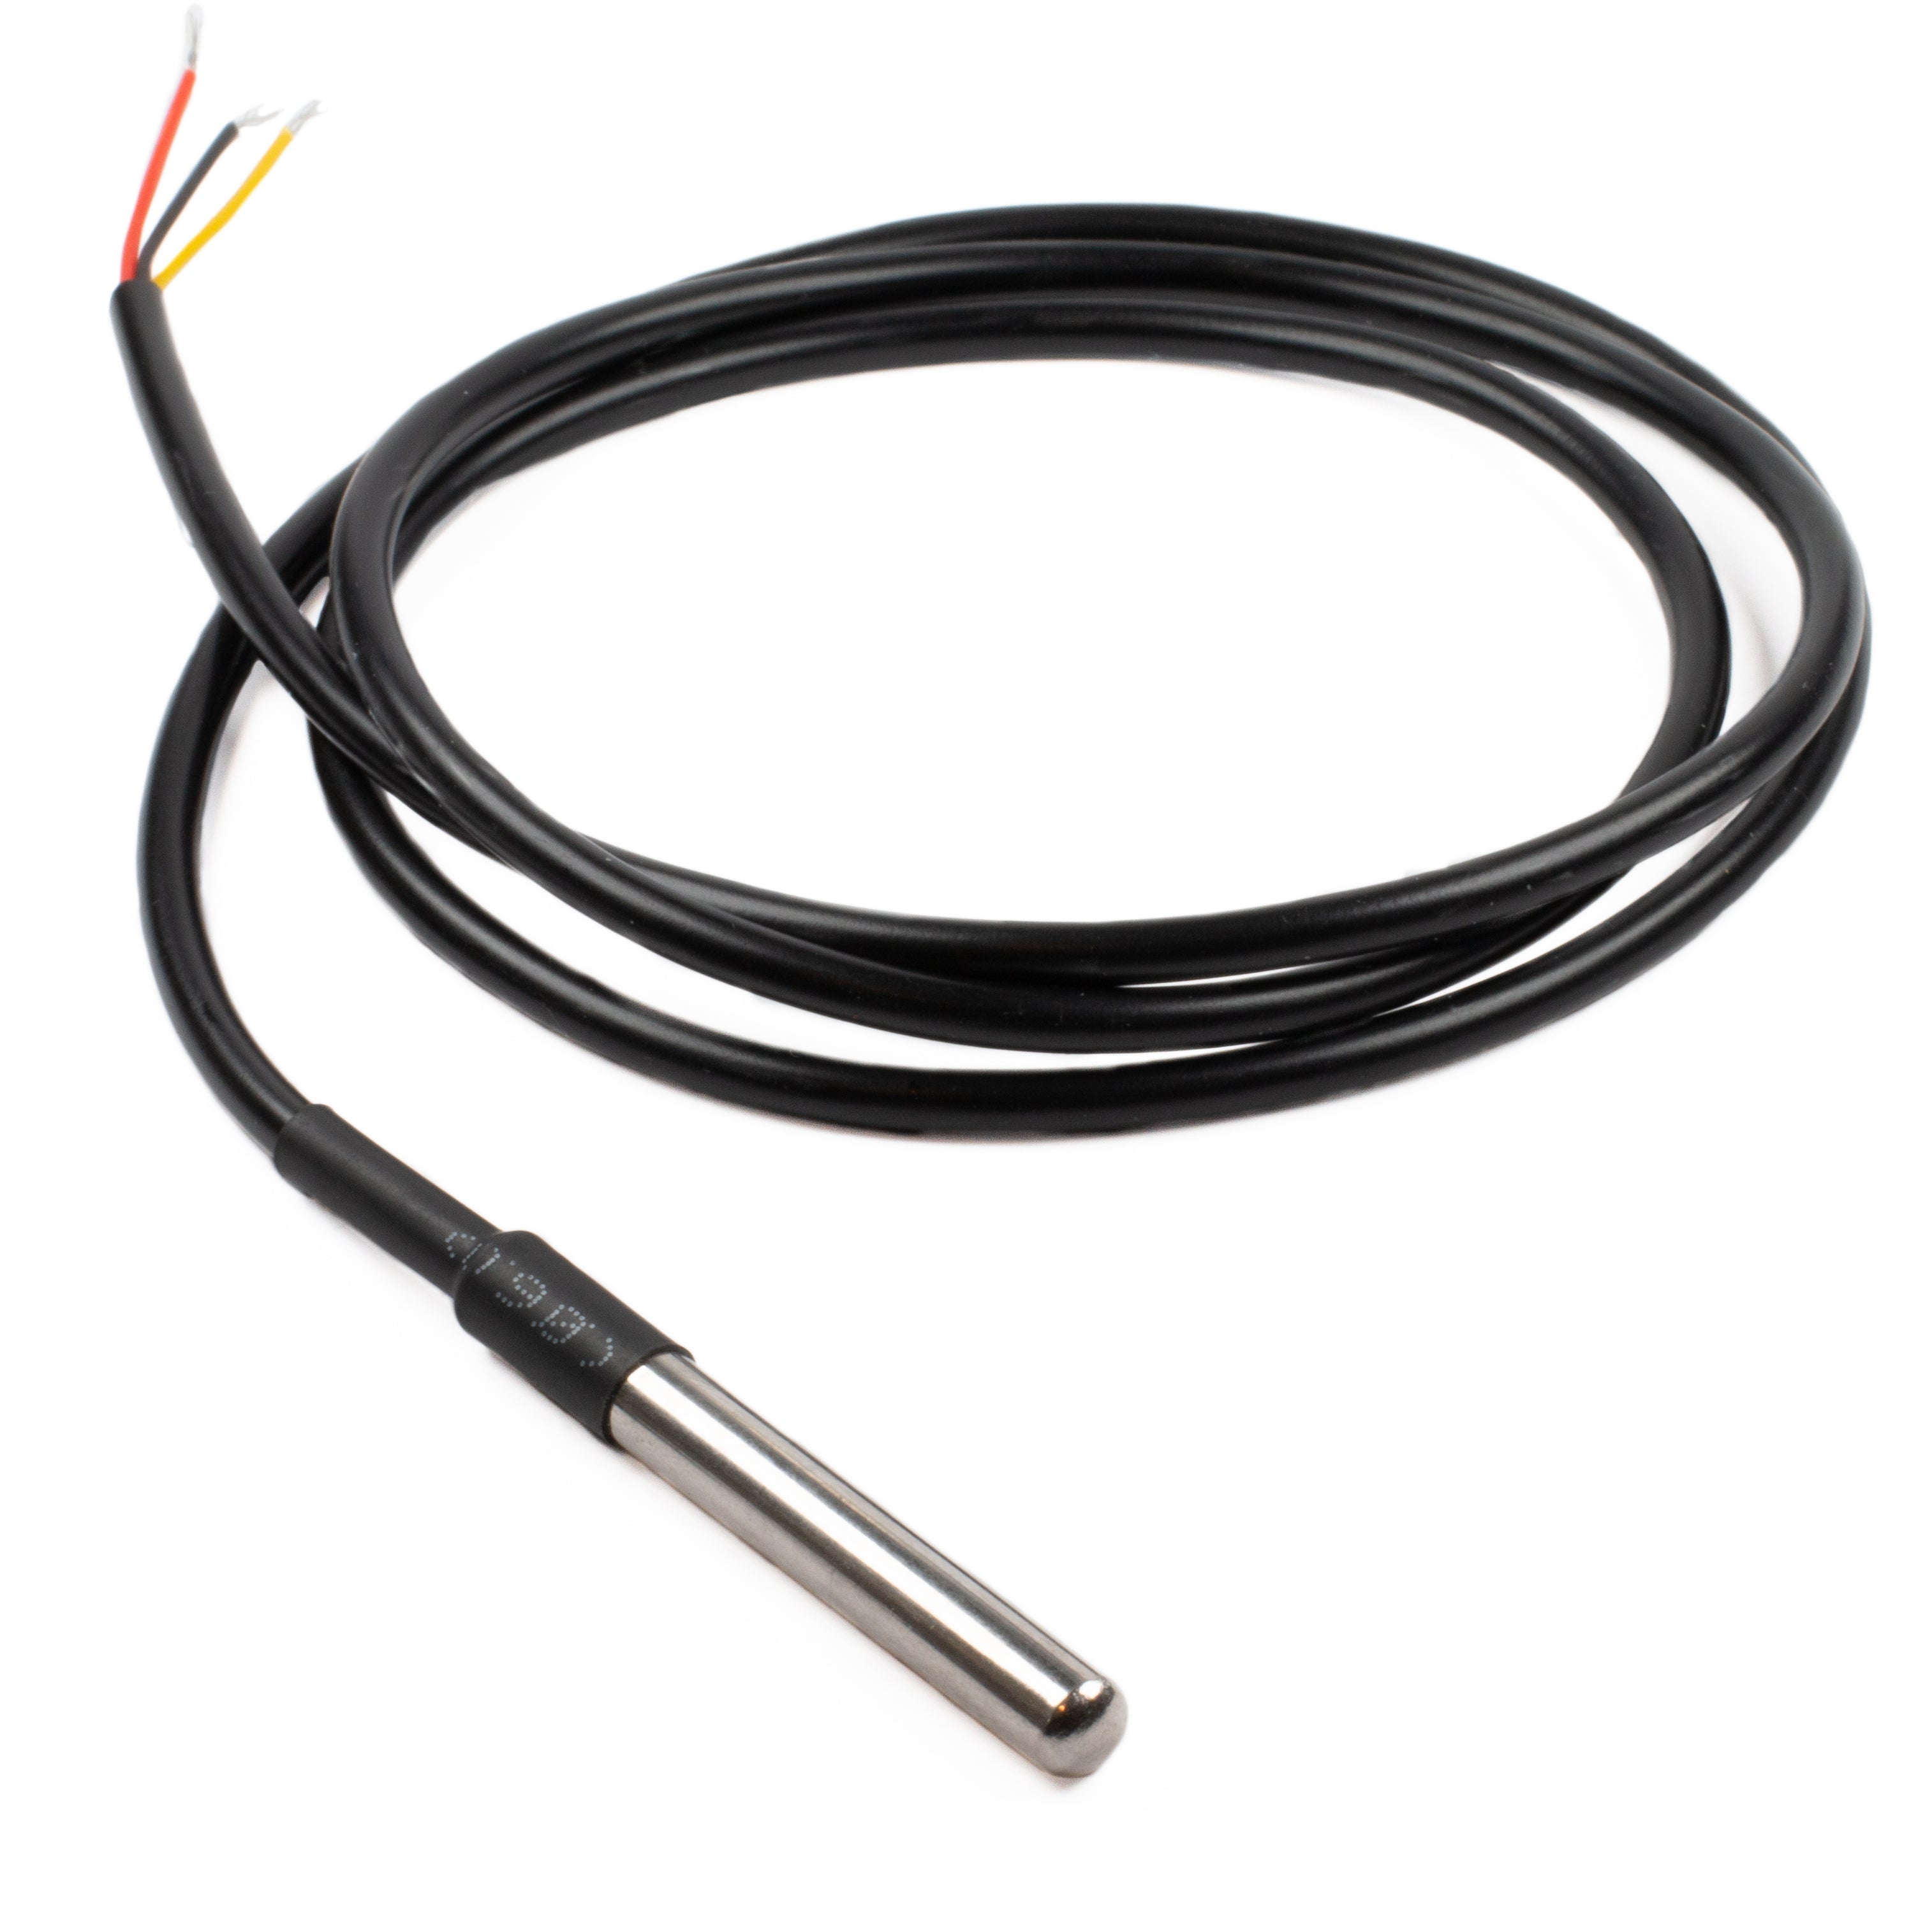
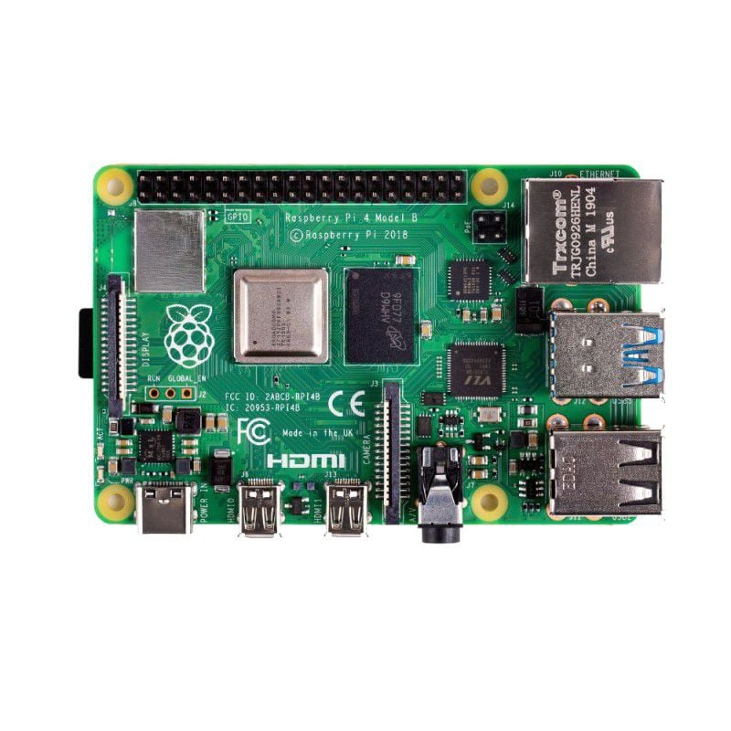
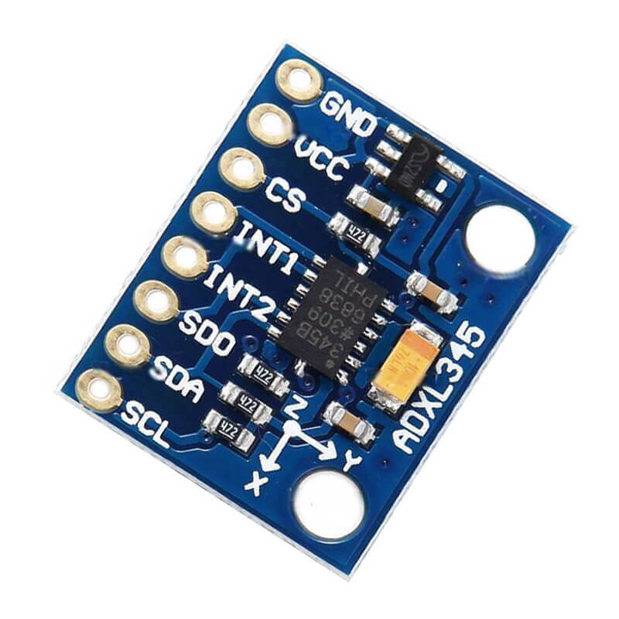
Resources
Hardware
Utilize the sensors used in the labs for this project
ADXL345 Triple-Axis Accelerometer
DS18B20 Thermocouple
Utilize the Raspberry Pi used in the labs
Optionally can use a Raspberry Pi Zero that is already owned

Slide 10
Tentative Tasks and Proposed Timeline
Sensor Deployment – Week 11
Develop mounts to affix sensors to the coffee machine
Develop a database schema to parse data into
Frontend Development – Week 13
Develop a front-end application to track sensor readings in real-time
Machine learning modelling – Week 16
Develop a machine learning model
Automated notifications – Reach Goal
Assign email credentials to the monitoring system to send an email once coffee is brewed

